Slide 1




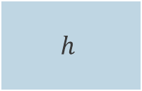
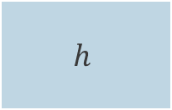

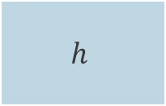
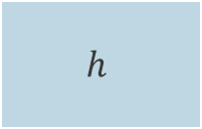
$$h$$
cat
$$h$$
$$h$$
$$h$$
« A grumpy cat held in hands »
« A grumpy cat held in hands »
$$h$$

Slide 2
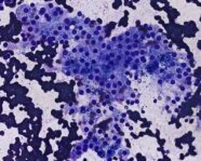
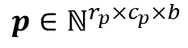
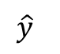
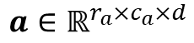
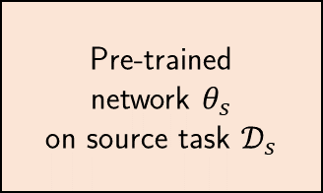
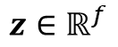
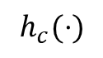
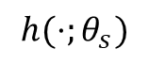
$$h(⋅;θ_{s})$$
$$h_{c}(⋅)$$
Pre-trained
network $θ_{s}$
on source task $𝒟_{s}$
Dimens. reduction
Classifier
resized centered
maximum
square crop
$$a∈ℝ^{r_{a}×c_{a}×d}$$
$$z∈ℝ^{f}$$
$$p∈ℕ^{r_{p}×c_{p}×b}$$
$$\hat{y}$$
Features extraction
Classification

Slide 3
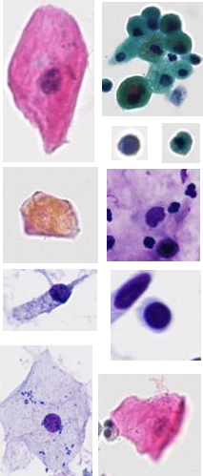
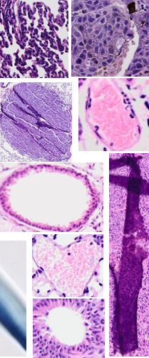
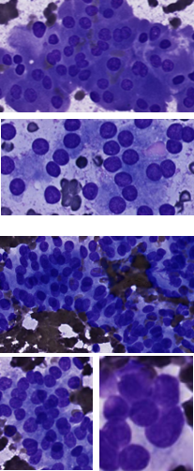
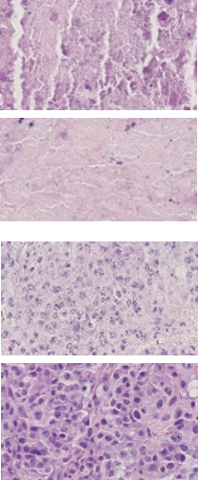
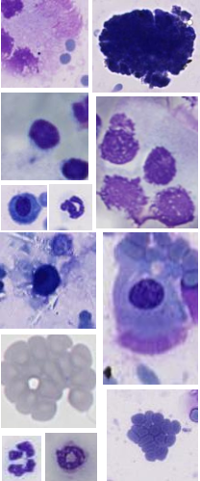
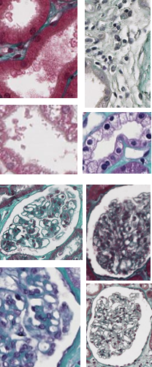
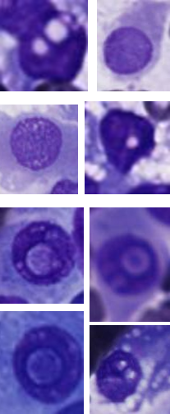
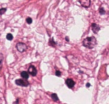
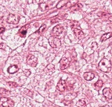
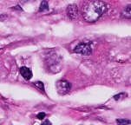
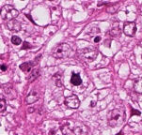
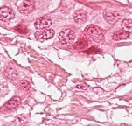
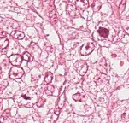
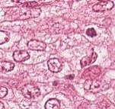
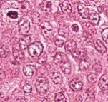
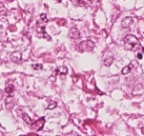
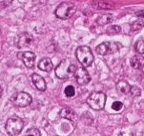
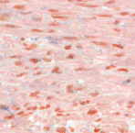
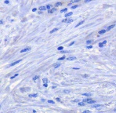
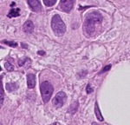
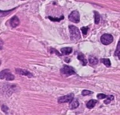


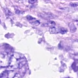
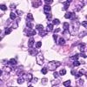
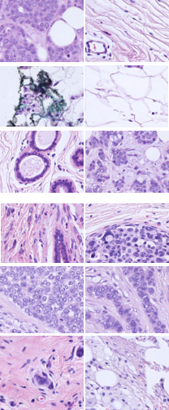
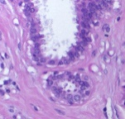
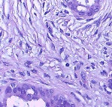
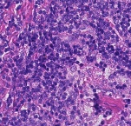
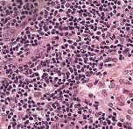
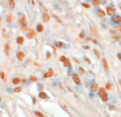
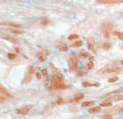
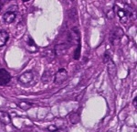
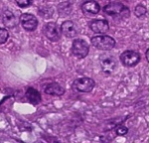
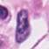

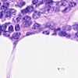
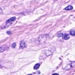
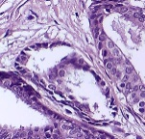
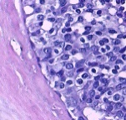

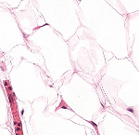




























































































Slide 4






















$$x=\left(\begin{matrix}x_{1}^{(1)} \\ x_{2}^{(1)} \\ \begin{aligned}x_{3}^{(2)} \\ x_{4}^{(4)} \\ ⋮ \\ x_{B−1}^{(T−1)} \\ x_{B}^{(T)}\end{aligned}\end{matrix}\right)$$
$$θ_{s}$$
$$z=\left(\begin{matrix}z_{1}^{(1)} \\ z_{2}^{(1)} \\ \begin{aligned}z_{3}^{(2)} \\ z_{4}^{(4)} \\ ⋮ \\ z_{B−1}^{(T−1)} \\ z_{B}^{(T)}\end{aligned}\end{matrix}\right)$$
$$θ_{1}$$
S
$$y^{(1)}$$
per-task loss
$$ℓ^{(1)}$$
$$Σ$$
$\frac{1}{B}$
$$θ_{2}$$
S
$$y^{(2)}$$
$$ℓ^{(2)}$$
$$θ_{3}$$
S
$$∅$$
$$⋮$$
$$ℒ$$
$$⋮$$
$$θ_{T−1}$$
S
$$y^{(T−1)}$$
$$ℓ^{(T−1)}$$
$$θ_{T}$$
S
$$y^{(T)}$$
$$ℓ^{(T)}$$

Slide 5



$$E=noise\left(x\right)+bias^{2}\left(x\right)+variance\left(x\right)$$
$$variance(x)$$
$$bias^{2}(x)$$
$$noise(x)$$
Trade-off
Complexity/capacity

Slide 6









Target task
Option 1: feature extraction
$$θ_{s}$$
C
$$x_{t}$$
Malignant Benign Benign
…
$$z_{t}∈ ℝ^{f}$$
$$y_{s}$$
Classify feature vector with a third-party classifier
(e.g. linear SVM)
$$θ_{s}$$
$$θ_{o}$$
Tree
Cat
Dogs
…
$$x_{s}$$
$$y_{s}$$
Use frozen network (no re-training) as feature extractor.

Slide 7
$$θ_{s}$$
$$θ_{o}$$
$$θ_{s}$$
$$θ_{n}$$
$$x_{o}$$
$$y_{o}$$
$$x_{n}$$
$$y_{n}$$
$$θ_{s}$$
$$θ_{o}$$
$$y_{o}$$
$$θ_{f}$$
$$θ_{t}$$
$$θ_{n}$$
$$x_{o}/x_{n}$$
$$θ_{n}$$
$$x_{o}$$
$$y_{o}$$
$$y_{n}$$
$$θ_{s}$$

Slide 8




















Pre-training
$$x_{s}$$
Transfer – feature extraction
$$x_{t}$$
$$y_{s}$$
$$θ_{s}$$
$$clf$$
$$y_{t}$$
$$θ_{s}$$
$${ θ}_{o}$$
Tree
Cat
Dogs
…
$$z_{t}∈ ℝ^{f}$$
Malignant Benign Benign
…
Pre-training
Transfer – fine-tuning
$$x_{s}$$
$$x_{t}$$
$$y_{s}$$
$$y_{t}$$
$$θ_{s}$$
$${ θ}_{o}$$
$$θ_{s}$$
$${ θ}_{n}$$
Malignant Benign Benign
…
Tree
Cat
Dogs
…

Slide 9


0
0
0
0
0
0
0
0
Kernel
1
2
3
0
5
6
8
1
9
2
0
2
3
5
0
7
4
6
2
3
7
0
$$σ\left(\begin{matrix} & \\ \begin{aligned} \\ \\ \\ \\ \\ \\ \end{aligned} & \end{matrix}\right)$$
0
1
0
52
47
42
0
2
1
3
8
7
5
0
41
80
91
0
4
0
7
5
0
9
0
Convolution
67
75
54
0
5
8
9
0
3
1
0
0
4
8
3
5
8
1
0
0
0
0
0
0
0
0
0
Stride ($s=2$)
Zero-padding

Slide 10























$$θ_{1}^{\left(2\right)}$$
$$σ$$
$$θ_{1}^{\left(1\right)}$$
$$σ$$
$$θ_{2}^{\left(2\right)}$$
$$σ$$
$$x_{1}$$
$$θ_{2}^{\left(1\right)}$$
$$σ$$
$$θ_{1}^{\left(3\right)}$$
$$σ′$$
$$y$$
$$x_{2}$$
$$θ_{3}^{\left(2\right)}$$
$$σ$$
$$h^{(3)}\left(⋅;θ^{\left(3\right)}\right)$$
$$x$$
$$θ_{3}^{\left(1\right)}$$
$$σ$$
$$h^{(1)}\left(⋅;θ^{\left(1\right)}\right)$$
$$θ_{4}^{\left(2\right)}$$
$$σ$$
$$h^{(2)}\left(⋅;θ^{\left(2\right)}\right)$$

Slide 11





Specimen
Small
Large
(biopsy)
(organ)
Fixation
Cut
Fixated sample in cassette
Dehydratation
Dehydrated sample
in cassette
Embedding
Tissue embedded in a paraffin block
Microtomy and application
Glass slide with unstained tissue
Staining
Glass slide with stained tissue and coverslip
Scanning

Slide 12




Slide 13



Slide 15













INPUT: a left out task $t_{1}$, a random seed, a combination $h$of HP, and a shared network $θ_{s}$
OUTPUT: an transfer evaluation score (computed on left out task validation set)
$𝒟_{1}$
$X_{train}$
$X_{val}$
$$X_{test}$$
$𝒟_{2}$
$𝒟_{3}$
Train in multi-task using shared network $θ_{s}$ and hyperparameters $h.$
Produces a pre-trained model$θ_{s}^{(MT)}$
$$θ_{s}^{(MT)}$$
$𝒟_{4}$
Extract features for left-out task
$𝒟_{5}$
(2)
(1)
$𝒟_{n}$
$Z_{train}$
$Z_{val}$
Train a SVM using the left-out task generated features
Evaluate transfer using validation features
Transfer score
(3)
(4)

Slide 16











$$𝒟_{j}$$
$$𝒟_{k}$$
 |  | $$r_{1j}$$
 |  | $$⋮$$
$$r_{i1}$$ | $$⋯$$ | $$r_{ij}$$
$${\overline{r}}_{ 0}^{(k)}$$
Best hyperparameters combination for left-out task $𝒟_{k}$:
Transfer protocol with pre-trained model $θ_{s}$ (the model trained with $Θ_{k}$).
Final evaluation on the test set of $𝒟_{k}$ for comparison to other approaches.
$$Θ_{i}$$
$${\overline{r}}_{ i}^{(k)}$$
$$Θ_{k}=arg \max_{Θ_{i}}{{\overline{r}}_{ i}^{(k)}}$$
Rank matrix
(with task $D_{k}$ ignored)

Slide 17






Our algorithm (I) / warm-up phase
$$𝒟_{s}$$
Model $θ_{0}$
Warm-up
$$𝒟_{l}$$
Supervised training (for W epochs)
Model $θ_{W}$

Slide 18









Model $θ_{0}$
Supervised warm-up on $𝒟_{l}$ (for W epochs)
Model $θ_{W}$
Self-training (epoch i $∈$ ]W, E])
$$𝒟_{s}$$
Pseudo-labeling
Sparsely-labeled
Model $θ_{i−1}$
Hard/soft label ?
$$𝒟_{l}$$
Self-training
Exhaustively-labeled
$$𝒟_{l}∪ 𝒟_{pl}$$
$𝒟_{pl}$ / pseudo-labeled
Supervised training
Model $θ_{i}$

Slide 19




Our algorithm (II) / self-training phase (b)
Model $θ_{W}$
Self-training (epoch i)
Pseudo-labeling
$$𝒟_{s}$$
Model $θ_{i−1}$
Hard/soft label ?
$$𝒟_{l}$$
$$𝒟_{pl}$$
Model $θ_{E}$

Slide 20



Our algorithm (II) / self-training phase (c)
Model $θ_{W}$
Self-training (epoch i)
Pseudo-labeling
$$𝒟_{s}$$
Model $θ_{i−1}$
Hard/soft label ?
$$𝒟_{l}$$
Self-training
$$𝒟_{pl}$$
$$𝒟_{l}∪ 𝒟_{pl}$$
Supervised training
Model $θ_{i}$
Model $θ_{E}$

